Slide 1

Inked
Book Recommender System
By Matia Landry, Isaac Latta

Slide 2

Problem Motivation
Design Problem:
Disorganized, inefficient traditional methods lead to duplicated efforts and low participation
Problem Statement:
Design and implement a mobile Book Recommender System that allows users to search for books, submit recommendations, and update ratings in real time, with administrative tools for managing the database

Slide 3

Objective
Develop an online recommender system to streamline the book selection and sharing process
It should…
Enable users to search and rate books remotely
Provide a central database for book recommendations
Offer administrative privileges

Slide 4

Single App with Local Storage
Pros
Simple
No networking
No backend hosting
Cons
No syncing across devices
Hard to push updates and enforce data integrity

Slide 5

External Books API With Minimal Backend
Pros
Access to rich book data
Less backend logic to maintain
Cons
Can't store user data
Limited control over API results
No Secure Authentication

Slide 6

Why We Rejected Them
Scalability
No Persistent Logic
No Authentication
No Social Interactions
Real-time sync limitations
Cant support social or collaborative functionality
Security risks
No Control over sensitive operations
Lack of extensibility
Cant support future dashboards and analytics

Slide 7

Final Solution

Slide 8

Overview
Hybrid Approach
External book API for real-time data with a secure backend and database.
Real-Time Sync
Centralized storage for user ratings, friend lists, and reading groups ensures consistent data across devices.
Key Benefits
Scalable design, easier updates, secure authentication.

Slide 9

Non-Functional Requirements
Performance
App launches under 2 seconds
UI responsiveness with smooth navigation and minimal delay
Security
Secure user authentication and data storage
Modifiability
Modular fragment design to ensure maintainability
Compatibility
Supports API level 19 (KitKat) or higher

Slide 10


Functional Requirements
Core Features of Inked
Remote access through user login
Book searching by title
Friends, reading groups and admin controls
Group recommendations for books

Slide 11

Software Architecture
High-Level Architecture
UI Layer (Fragments, Adapters)
Controller (Singleton)
Services (AuthService, BookService etc)
Store
External APIs
Design Patterns
Singleton for Controller & Store (single source of truth)
Observer pattern with StoreListener interface (UI Auto Updates)

Slide 12

AWS Infrastructure
AWS EC2
Hosts Flask backend on low-footprint micro instance
AWS RDS (PostgreSQL)
Central database for storing users, books, ratings friendships etc.
AWS API Gateway
Filters requests, enforces necessary headers and arguments
Security Groups
Restrict traffic; API Gateway -> EC2, only EC2 -> RDS

Slide 13

Backend Architecture
Flask + Blueprints
auth.py -> Login endpoint, JWT generation
books.py -> Book search, saving/rating
friends.py -> Friend requests, list remove
reading.py -> Reading groups, recommendations
Key Endpoints
/login, /search_book, /book, /friend/…, /reading/group/…
Request/Response Flow
Validate Token -> Perform DB/API calls -> Return JSON with status flag

Slide 14

_{Security & Data Integrity}
Authentication
JWT-based login for session management
API Gateway & x-api-key
Enforces an additional security layer
Restricted Network Paths
Only API Gateway -> EC2, only EC2 -> RDS
Validation & Error Handling
Parameterized queries
Robust backend checks

Slide 15
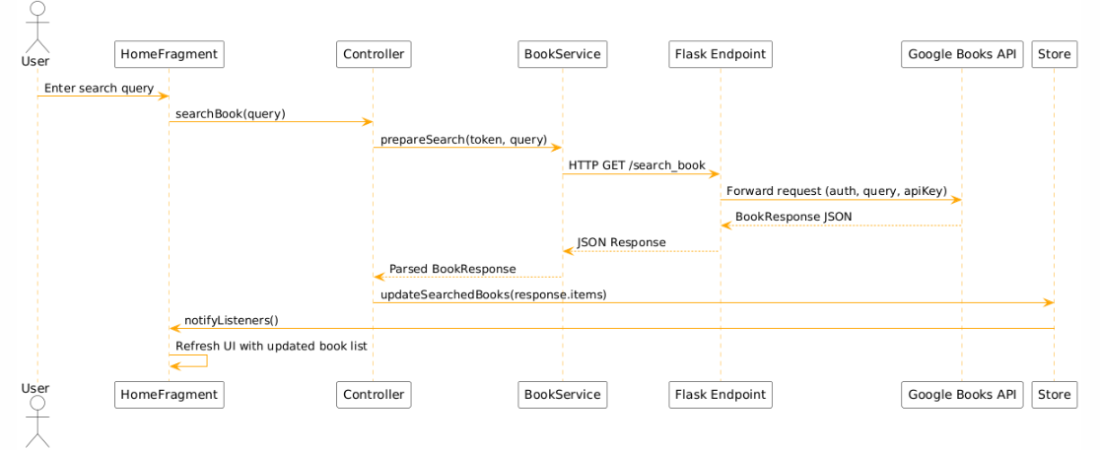
Search Book Request Flow

Slide 16

Used Standards
Android Development
API Level 19+
Security
JWT Authentication
API Gateway
Parameterized queries
AWS Best Practices
Data Formatting
JSON Response
Status Codes

Slide 17

Environmental, Social, Ethical, & Safety Aspects
Environmental
EC2 micro instance minimizes power
API Gateway filters requests—reducing overhead on server
Social & Ethical
Encourages reading culture & collaboration
Inclusive Design; simple color scheme & UI
Safety
JWT-based auth, restricted in/outbound traffic
Minimal user data collected

Slide 18

Lessons Learned
Technical
Importance of design patterns (Singleton, Observer)
Value of robust security & proper configuration
Teamwork
Coordinating tasks & merging code
Effective communication in planning
Project Management
Balancing features vs. time constraints
Importance of early testing & iterative design

Slide 19

Demo

Slide 20

Future Work & Limitations
Limitations
Reliance on External APIs
Basic UI & Schema
Flask Not Fully Async
Potential Improvements
More Advanced recommendation algorithms
Offline

Slide 21

Conclusion
Summary
Remote book recommendations
Supports friend networks, reading groups, and friend networks
Integrates with an external AWS & Google Books API
Modular & Extensible software architecture

Slide 22

Thank You

